Slide 1

Cars24 Analysis Using Web Scraping and Data Analysis

Slide 2
About me
Background : Btech
Why you want to learn Data Science: I want to learn Data Science to develop practical skills and build a career in the IT field.
Work experience : Fresher
LinkedIn : https://www.linkedin.com/in/samudrala-praharshitha-a8706436b
GitHub : https://github.com/SamudralaPraharshitha24

Slide 3
Table of contents
Project Overview
Business Scenario
Business Objectives
Dataset Overview & Data Dictionary
Data Collection, Cleaning & Preprocessing
Analysis of the Objectives
Overall Key Findings
Business Recommendations
Conclusion

Slide 4
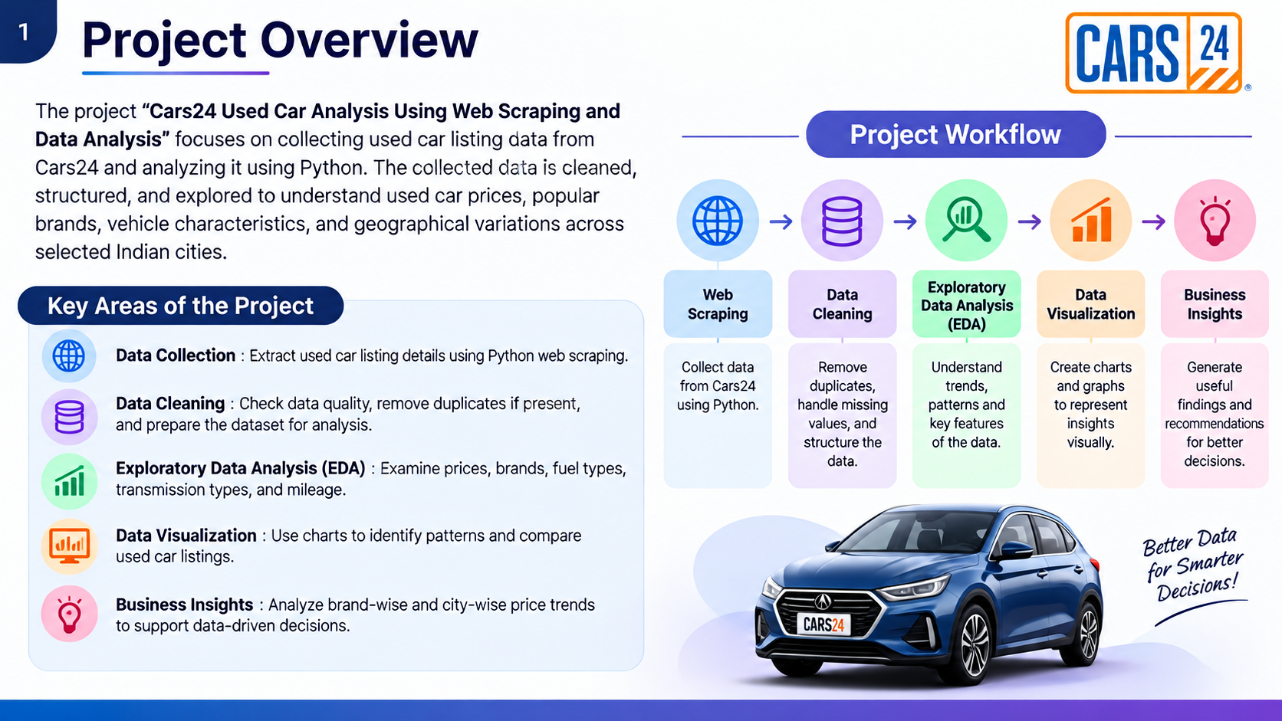
Project Overview
The project “Cars24 Used Car Analysis Using Web Scraping and Data Analysis” focuses on collecting used car listing data from Cars24 and analyzing it using Python.
The collected data is cleaned, structured, and explored to understand used car prices, popular brands, vehicle characteristics, and geographical variations across selected Indian cities.
Key Areas of the Project
Data Collection: Extract used car listing details using Python web scraping.
Data Cleaning: Check data quality, remove duplicates if present, and prepare the dataset for analysis.
Exploratory Data Analysis: Examine prices, brands, fuel types, transmission types, and mileage.
Data Visualization: Use charts to identify patterns and compare used car listings.
Business Insights: Analyze brand-wise and city-wise price trends to support data-driven decisions.

Slide 5
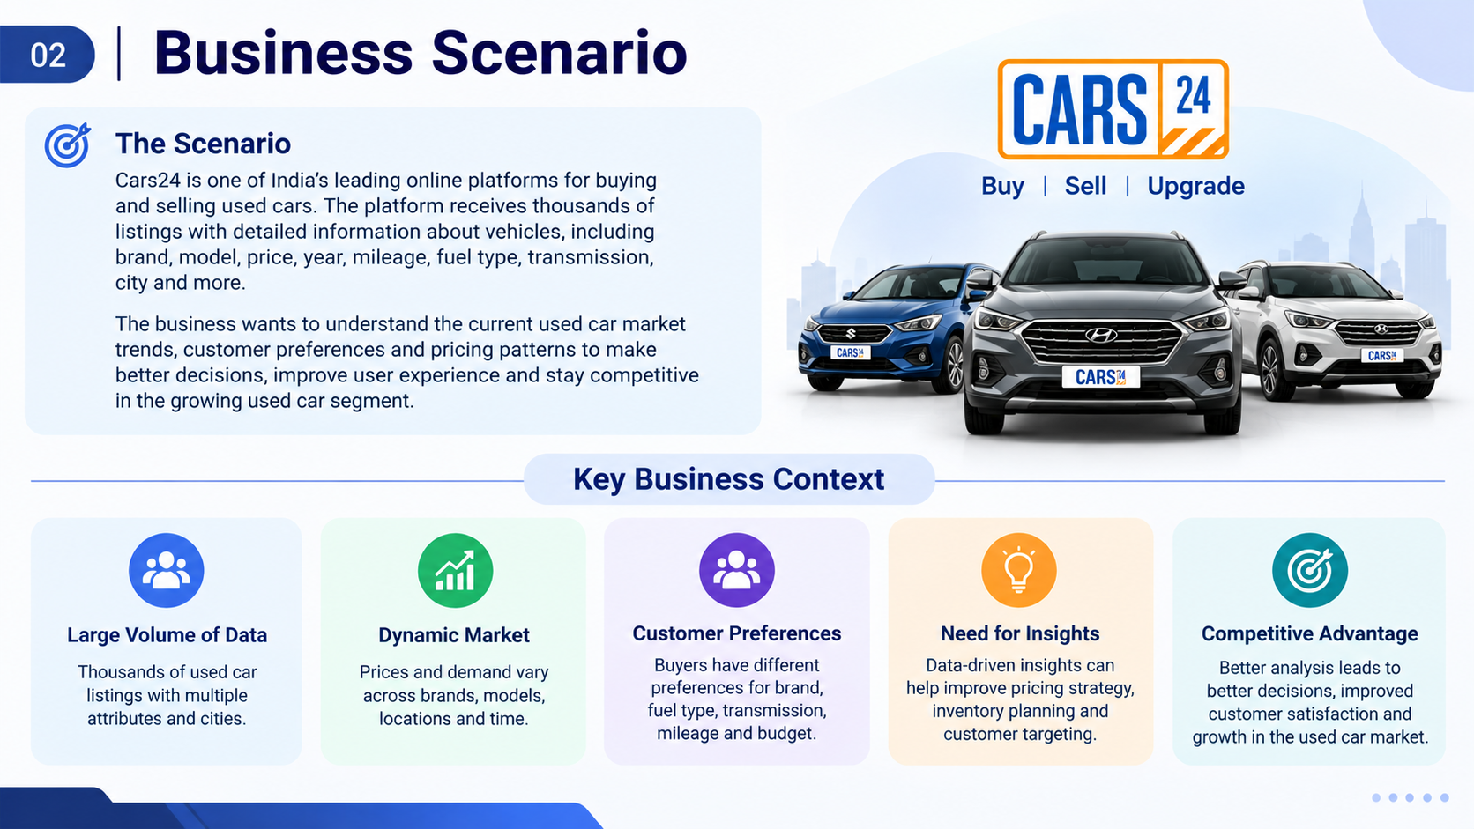
BUSINESS SCENARIO
Key Business Context
Large Volume of Data: Used-car listings contain multiple vehicle attributes.
Dynamic Market: Prices vary across brands, models, and locations.
Customer Preferences: Buyers have different needs regarding price, mileage, fuel type, and transmission.
Need for Insights: Data analysis can help identify market trends and pricing patterns.
Competitive Advantage: Better insights can support informed business decisions.

Slide 6
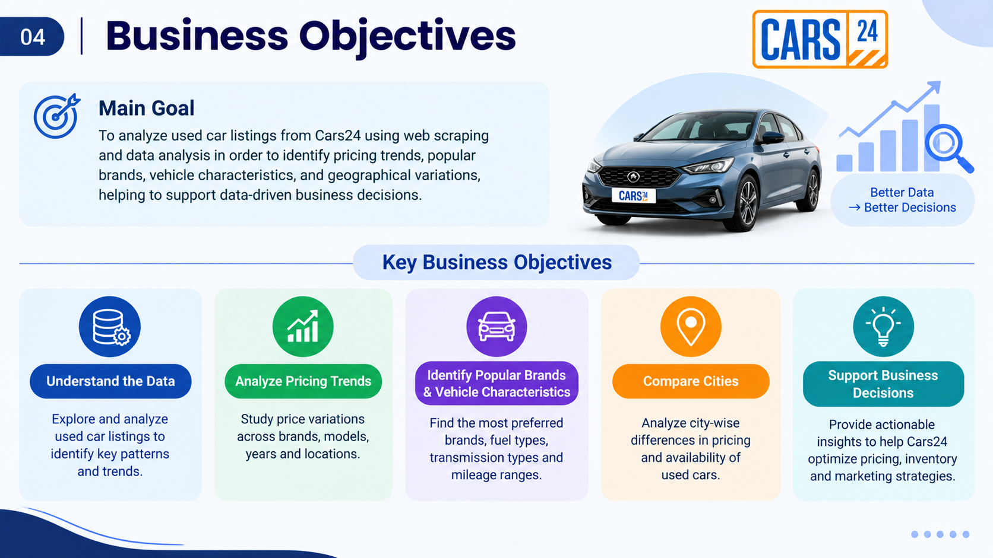
Business Objectives
The project aims to transform Cars24 used-car listing data into meaningful information for market analysis.
Examine the quality and structure of collected data.
Understand the distribution of used-car prices.
Explore relationships between vehicle age, mileage, and price.
Evaluate brand and city-wise listing patterns.
Identify practical insights from the available sample data.

Slide 7
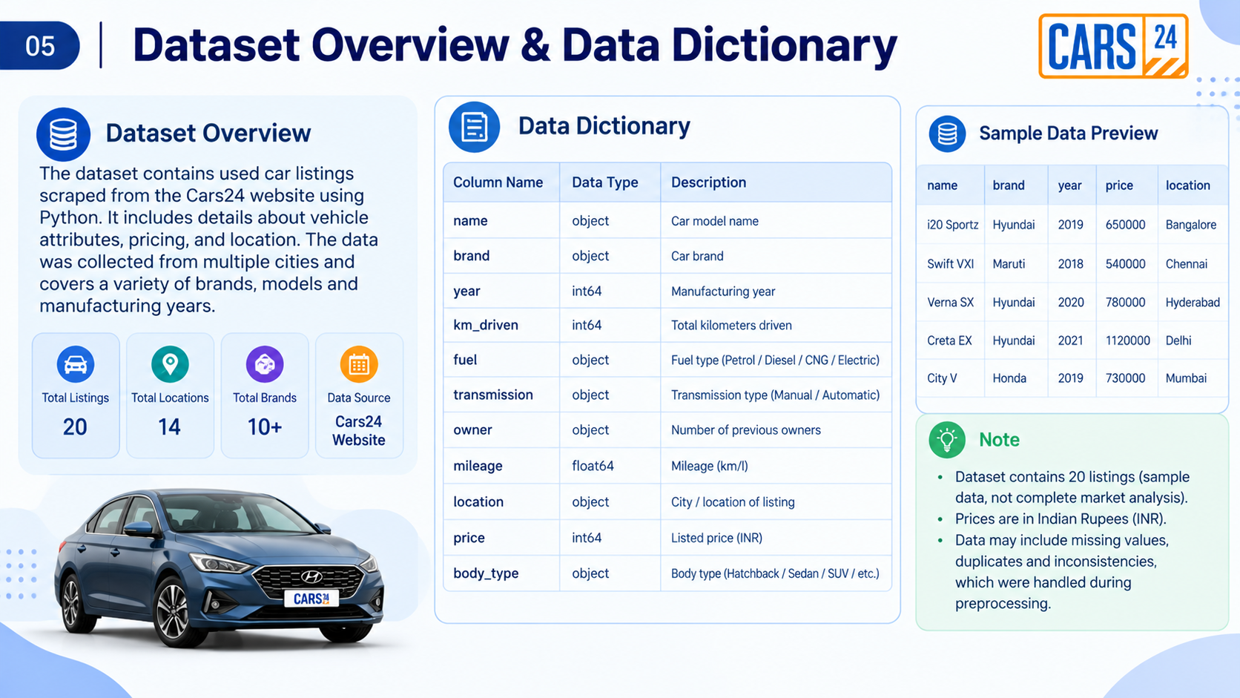
DATASET OVERVIEW & DATA DICTIONARY
Dataset Overview
Data Source: Cars24 website
Total Listings: 20
Locations Covered: 14
Total Columns: 14
Data Format: Structured tabular dataset

Slide 8
car_name | location
0 | 2022 Renault TRIBER RXZ AMT | Kochi
1 | 2018 Honda City 1.5L I-VTEC VX CVT | Pune
2 | 2021 Hyundai NEW I20 N LINE N8 1.0 TURBO GDI DCT | Patna
3 | 2019 Maruti Dzire VXI | Indore
4 | 2024 Honda Amaze 1.2L I-VTEC VX | Rajkot
5 | 2015 Hyundai Creta S 1.6 PETROL | Patna
6 | 2021 MG HECTOR PLUS SHARP 1.5 PETROL TURBO DCT... | Delhi NCR
7 | 2021 Hyundai NEW I20 SPORTZ 1.2 AT | Dehradun
8 | 2023 KIA SELTOS HTK 1.5 DIESEL IMT | Ludhiana
9 | 2020 KIA SONET GTX PLUS 1.0 DCT DUAL TONE | Hyderabad
10 | 2025 Tata NEXON CREATIVE PLUS S 1.2 REVOTRON 6 MT | Delhi NCR
11 | 2018 Hyundai Elite i20 ASTA 1.2 DUAL TONE | Kolkata
12 | 2025 Renault Kiger RXT (O) AMT | Bangalore
13 | 2017 Hyundai Elite i20 MAGNA EXECUTIVE 1.2 | Jaipur
14 | 2019 KIA SELTOS GTX PLUS DCT 1.4 PETROL | Pune
15 | 2023 KIA SELTOS GTX PLUS 1.5 DIESEL AT | Hyderabad
16 | 2023 Mahindra XUV700 AX 7 P AT 7 STR | Mumbai
17 | 2021 Tata NEXON XZ PLUS PETROL SUNROOF | Bangalore
18 | 2021 Nissan MAGNITE XE | Delhi NCR
19 | 2019 Datsun Redi Go S 1.0 | Coimbatore

Slide 9
DATA COLLECTION – WEB SCRAPING
Data Source: Cars24 website
Collection Method: Web scraping using Python
Data Extracted: Car name, brand, model, year, price, mileage, fuel type, transmission, body type, and location
Data Storage: Structured into a Pandas DataFrame for analysis
Final Dataset: 20 used-car listings with 14 columns
Outcome: A structured dataset prepared for data cleaning, exploratory data analysis, and visualization.

Slide 10
DATA CLEANING
The collected Cars24 dataset was checked to ensure data quality before analysis.
Missing Values: No missing values found.
Duplicate Records: No duplicate rows found.
Duplicate Listings: No duplicate listing URLs found.
Data Structure: Verified 20 records and 14 columns.
Preparation: Organized the dataset for exploratory data analysis and visualization.
Outcome: The dataset was checked and prepared for further analysis.

Slide 11
EXPLORATORY DATA ANALYSIS (EDA)
 | year | price | mileage_km
count | 20.000000 | 2.000000e+01 | 20.00000
mean | 2020.750000 | 7.671656e+05 | 47729.70000
std | 2.672964 | 3.457348e+05 | 24712.50087
min | 2015.000000 | 2.796250e+05 | 4482.00000
25% | 2019.000000 | 5.133252e+05 | 29666.25000
50% | 2021.000000 | 7.336970e+05 | 45887.50000
75% | 2023.000000 | 9.217118e+05 | 68014.75000
max | 2025.000000 | 1.622028e+06 | 86039.00000

Slide 12
DATA VISUALIZATION
Python visualization libraries were used to represent patterns in the collected used-car data.
Charts Created
Car Price Distribution — Histogram
Manufacturing Year vs. Price — Scatter Plot
Mileage vs. Price — Scatter Plot
Number of Cars by Fuel Type — Count Plot
Number of Cars by Body Type — Count Plot
Average Used-Car Price by City — Horizontal Bar Chart
Correlation Analysis — Heatmap
Libraries: Matplotlib and Seaborn
Purpose: To make price patterns, vehicle characteristics, and city-wise differences easier to understand.

Slide 13
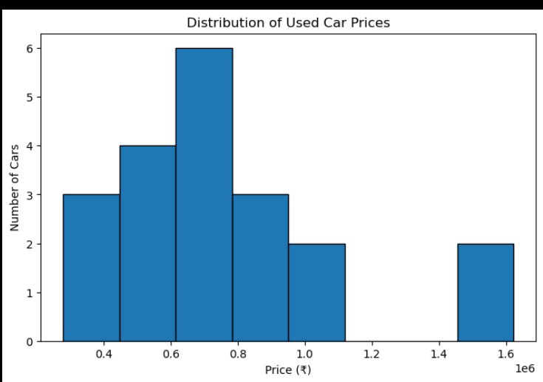
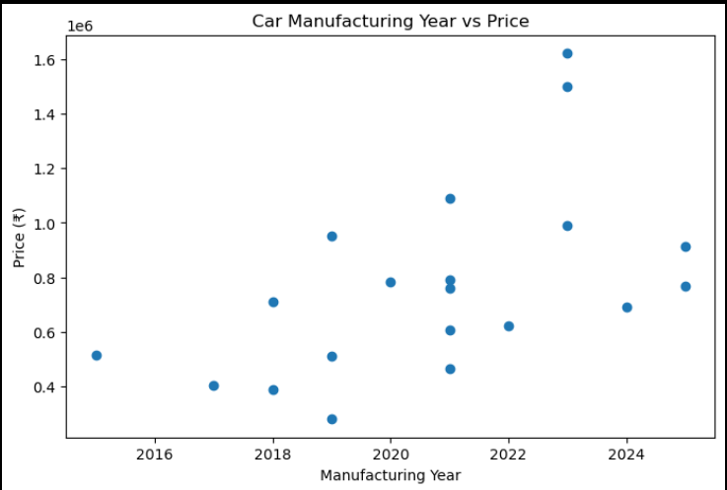
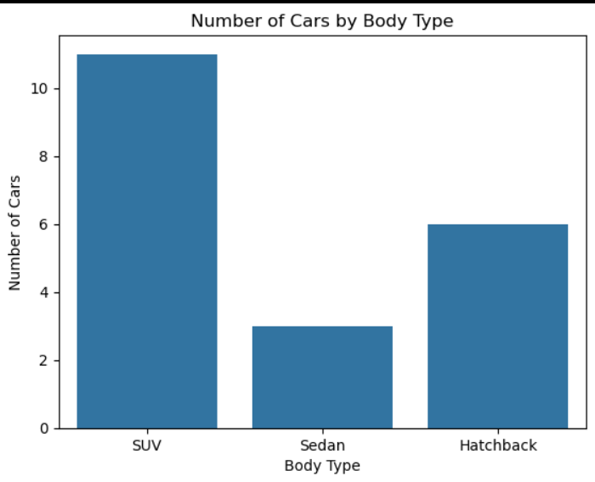
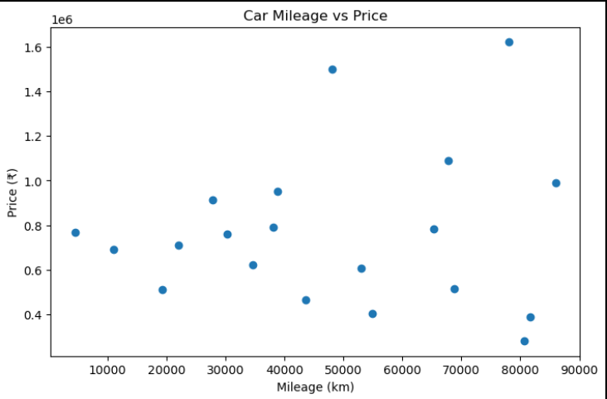
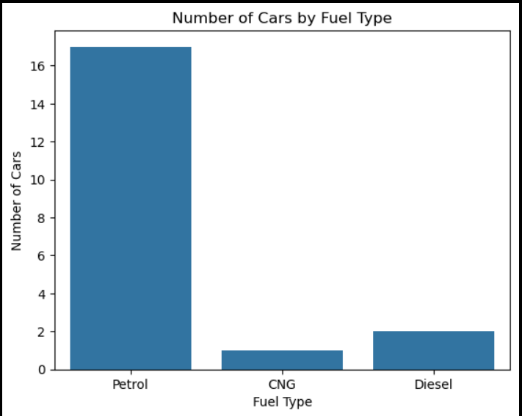
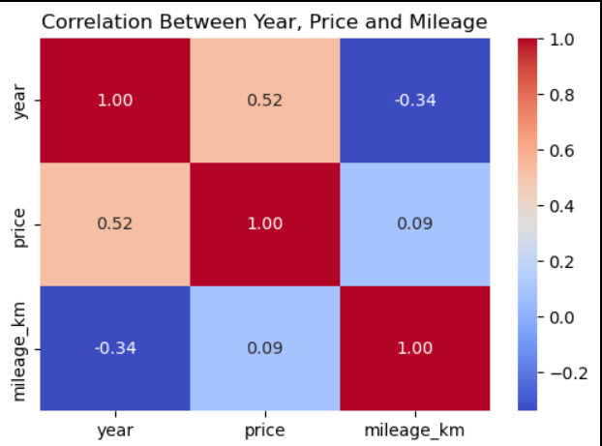
Car Price Distribution — Histogram Manufacturing Year vs. Price — Scatter Plot Number of Cars by Body Type-Count Plot
Mileage vs. Price — Scatter Plot Number of Cars by Fuel Type — Count Plot Correlation Analysis Heatmap

Slide 14
Problem Statement
BRAND-WISE USED CAR ANALYSIS
Total Brands: 10
Top Brand: Hyundai — 5 listings
Second Highest: KIA — 4 listings
Other Brands: Tata, Honda, Renault, Mahindra, MG, Maruti, Nissan, and Datsun
Key Finding: Hyundai and KIA together represent 9 out of the 20 collected listings.
Analysis Objective: Understand which brands appear most frequently in the collected Cars24 listings.
brand | Count | mean | median
Mahindra | 1 | 1622028.00 | 1622028.0
MG | 1 | 1088682.00 | 1088682.0
KIA | 4 | 1055641.25 | 969908.0
Tata | 2 | 850985.00 | 850985.0
Honda | 2 | 699239.00 | 699239.0
Renault | 2 | 693306.50 | 693306.5
Hyundai | 5 | 534143.60 | 514634.0
Maruti | 1 | 509399.00 | 509399.0
Nissan | 1 | 463234.00 | 463234.0
Datsun | 1 | 279625.00 | 279625.0

Slide 15
AREA-WISE USED CAR ANALYSIS
The collected Cars24 listings were analyzed across different Indian locations to understand geographical differences in used-car prices.
Locations Covered: 14
Total Listings: 20
Analysis Focus: Compare average used-car prices across selected locations.
Purpose: Identify locations with relatively higher or lower average listing prices.
Key Observation: The dataset covers multiple locations, but each location has only a small number of listings. Therefore, the results represent the collected sample rather than the overall used-car market in each city.
Visualization: Insert your existing horizontal bar chart showing average used-car prices by city.
count | mean | median
location
Delhi NCR | 3 | 821311.0 | 912017.0
Bangalore | 2 | 777927.5 | 777927.5
Hyderabad | 2 | 1141374.5 | 1141374.5
Patna | 2 | 636554.0 | 636554.0
Pune | 2 | 829858.0 | 829858.0
Coimbatore | 1 | 279625.0 | 279625.0
Dehradun | 1 | 607526.0 | 607526.0
Indore | 1 | 509399.0 | 509399.0
Jaipur | 1 | 403007.0 | 403007.0
Kochi | 1 | 620711.0 | 620711.0
Kolkata | 1 | 387077.0 | 387077.0
Ludhiana | 1 | 989020.0 | 989020.0
Mumbai | 1 | 1622028.0 | 1622028.0
Rajkot | 1 | 689558.0 | 689558.0

Slide 16
BUSINESS RECOMMENDATIONS
Based on the analysis of the collected Cars24 listings, the following recommendations can be considered:
Pricing Strategy: Use brand, model year, and mileage to support price comparisons.
Brand Analysis: Monitor frequently listed brands such as Hyundai and KIA.
Customer Preferences: Study the distribution of fuel types and body types to understand patterns in the sample.
Location-Based Analysis: Compare average listing prices across cities when evaluating regional differences.
Data Expansion: Collect more listings from each location to improve the reliability of future analysis.
Expected Benefit: These insights can support better understanding of used-car listings and help guide further market analysis.
Key business metrics Compare average price by fuel type
Average Price: 767165.6
Median Price: 733697.0
Average Mileage: 47729.7
Total Listings: 20
count | mean | median
fuel_type
CNG | 1 | 1088682.00 | 1088682.0
Diesel | 2 | 1245009.50 | 1245009.5
Petrol | 17 | 692035.94 | 689558.0

Slide 17
CONCLUSION
This project analyzed used-car listings collected from Cars24 using web scraping and Python-based data analysis.
Collected and analyzed 20 used-car listings across 14 locations.
Examined pricing patterns, vehicle characteristics, fuel types, transmission types, and body types.
Identified Hyundai as the most represented brand in the collected dataset.
Explored brand-wise and location-wise listing patterns through data visualization.
Derived practical recommendations for pricing comparisons and further market analysis.
Final Outcome: The project demonstrates how web scraping, data cleaning, exploratory data analysis, and visualization can transform raw used-car listing data into meaningful insights.

Slide 18

THANK YOU

